Slide 1
Global Perspectives on Inclusive Well-Being: The Role of Health and Wellness Coaching in Fostering Diversity, Equity, Inclusion, and Belonging
Empowering Individuals, Leaders, Service Providers, and Advocates of DEIB Through the Lens of Health and Wellness Coaching
February, 2024
Notes:
Health and Wellness Coaching in the Workplace Setting
Context, International Landscape, and Future Outlook

Slide 3
Purpose: to offer guidance and insight to individuals, leaders, service providers, and advocates of DEIB worldwide.
Reframe
DEI(B) in a well-being context
Understand
the distinct and valuable role played by Health and Wellness Coaches in fostering Diversity, Equity, Inclusion, and Belonging
Clarify
the distinct and valuable role played by Health and Wellness Coaches in fostering Diversity, Equity, Inclusion, and Belonging
Increase
awareness of the current global context of Diversity, Equity, Inclusion, and Belonging
Provide
Provide resources to help leaders and providers inform, educate, and create the ripple effect of positive change

Slide 4
Present real-life stories, testimonials or studies we’ve termed “Voices from the Field”, illustrating the true effectiveness of Health and Wellness Coaching in the specific domains of Diversity, Equity, Inclusion, and Belonging encompassing:
Race and Ethnicity
Age and Generations
Gender
Sexual Orientation
Religious and Spiritual Beliefs
Disability
Socioeconomic Status and Background
Neurodiversity
Health Status
Weight Stigma and Body Image

Slide 5
Overview
Definition of DEI & B
Why DEIB Today
Reframing DEIB in a Well-Being Context
Definition of Health and Wellness Coaching
Health and Wellness Coach Training for DEIB
Definition of well-being
Types of Diversity:
What it is
Why it matters
How HWC can support this type of diversity?
Voices from the Field
Race and Ethnicity
Age and Generation Diversity
Gender
Sexual Orientation
Religious and Spiritual Diversity
Physical Disability
Socio-economic Status and Social Determinants of Health
Health Status
Neurodiversity and ADHD
Weight Bias and Stigma
VIII. Closing the case for DEIB through Health and Wellness Coaching
VIV. What’s being done
X. The Diversity of Health and Wellness Coach Specialties
XI. Final Thoughts, Calls to Action, and Conclusion
XII Questions for Discussion Guide
XIII. Inclusive Language Glossary and Resources

Slide 6
I. Definition of DEIB

Slide 7
Structural inequality and bias are global phenomena
Diversity: proportionate representation across all dimensions of human difference.
Inclusion: everyone is included, visible, heard, and considered.
Belonging: everyone is treated and feels like a full member of the larger community and can thrive.
Notes:
belonging as “The feeling of security and support when there is a sense of acceptance, inclusion, and identity for a member of a certain group or place.”

Slide 8
II. Why DEIB Today

Slide 9
History
A 2020 survey conducted by Fortune and Deloitte revealed that 96% of CEO’s agree that DEIB is a personal strategic priority
Workplace diversity training emerged following equal employment laws, AA, etc.
Social Movements (George Floyd, Me-Too, etc.)
Global Migration
Increasingly complex and interconnected world
Globalization
Technology advancing, diversity is fabric of modern society
Financial incentives for organiza-tions
Increased loneliness
1960… largely ineffective… incentive for change…
2023
Notes:
incentive for change. The recent boom of the DEIB industry coincides with current social movements such as the protests following the death of George Floyd in May 2020 in the USA, an increase in global migration leading to more diverse nations in the past 20 years (Rosenberg, 2019) along with an undeniable reality that the Internet has become a dominant force in the acceleration of global cultural exchange.

Slide 10
III. Reframing DEIB in a well-being context
Notes:
Reframing DEIB in a well-being context

Slide 11
Connected & Synchronized
Well-Being
DEIB
Mental
&
Physical Health

Slide 12
Social-Ecological Model of Health: Health is affected by the interaction between individual, group/community, physical, social, and political environments.
Society
Community
Relationship
Individual

Slide 13
IV. Definition of Health & Wellness Coaching
Notes:
Reframing DEIB in a well-being context

Slide 14
“Health and Wellness Coaches work collaboratively with individuals and groups in a client-led process that supports the client in working toward self-determined health and wellness goals. Coaches support and encourage clients to become masters of their own health, wellness, and overall well-being.” — (Global Wellness Institute Global Coaching Initiative, 2022)

Slide 15
“Medical Coaching is a coaching methodology that enables clients to develop emotional, mental and physical resilience in a medical crisis or challenge”. — Medical Coaching Institute, 2011)

Slide 16
V. Health & Wellness Coach Training for DEIB

Slide 17
Credentialing
Health and Wellness Coaching is not credentialed or regulated globally. Industry leaders include:
National Board of Health and Wellness Coaches (NBHWC-USA)
UK Health Coaches Association (UKHCA)
Health Coach Association of New Zealand/Australia (HCANZA)
Health Coach Alliance in Canada (HCA).
Notes:
The Industry leaders at the time of this paper are the United States National Board of Health and Wellness Coaches (NBHWC), the United Kingdom & International Health Coaching Association Ltd (UKIHCA), Health Coaches Australia and New Zealand Association (HCANZA) and the Health Coach Alliance in Canada (HCA).

Slide 18
Accredited (NBHWC, ICF) Training Encompasses
Cultural Competence & Awareness
Intersectionality
Communication & Active Listening
Bias Awareness & Mitigation
Inclusive Language & Practices
Knowledge of Health Disparities & Social Determinants of Health
Ongoing Professional Development
Lifelong Cultural Humility
Coaching Ethics
Notes:
The Industry leaders at the time of this paper are the United States National Board of Health and Wellness Coaches (NBHWC), the United Kingdom & International Health Coaching Association Ltd (UKIHCA), Health Coaches Australia and New Zealand Association (HCANZA) and the Health Coach Alliance in Canada (HCA).

Slide 19
VI. Definition of Well-Being

Slide 20
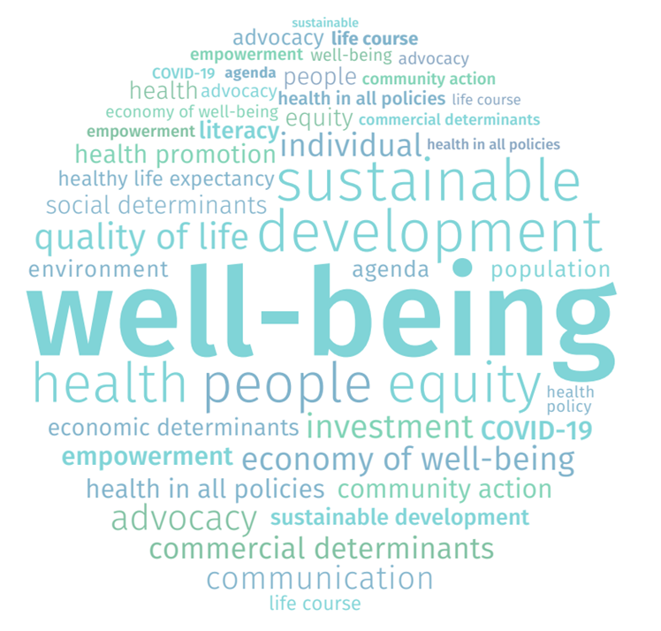
“Health and Well-Being are inextricably linked.”
"Health is a state of complete physical, mental, and social well-being and not merely the absence of disease or infirmity.”
— WHO

Slide 21
Potential Sources to Cultivate Well-Being
Potential Sources to Cultivate Well-Being
Nourishment/Quality Nutrition Environment & Surroundings Mindfulness/Reflection Contributions/Meaning/Purpose Intellectual Stimulation Financial Stability Spirituality Self-Awareness Opportunities for Growth | Altruism & Impact Self-Direction & Agency Constructive Relationships Connection/Community Rest & Recovery Constructive Emotions Creativity & Play Nature & Sunlight Movement/Physical Activity

Slide 22
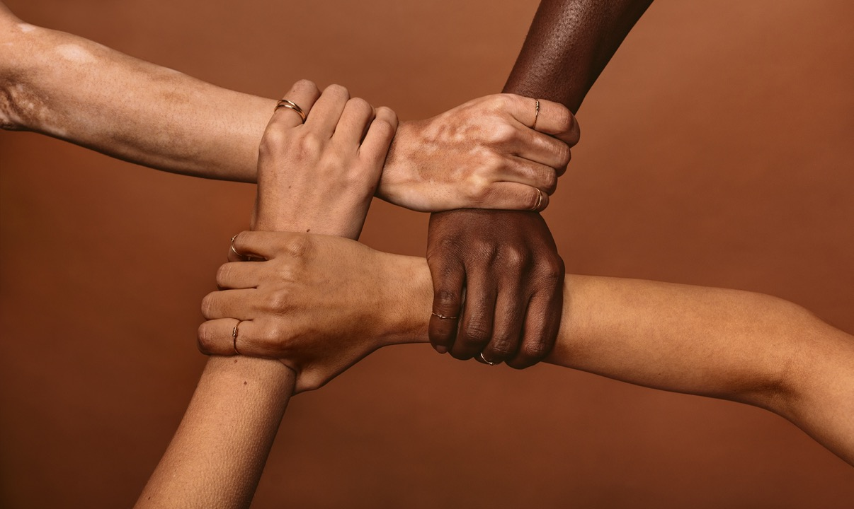
VII. Types of Diversity (11)
What it is
Why it matters
How HWC can support this type of diversity
Voices from the Field
Notes:
Types of Diversity:
What it is
Why it matters
How HWC can support this type of diversity?
Voices from the Field

Slide 23
VII. 1. Race & Ethnicity 2. Age & Generation 3. Gender 4. Sexual Orientation 5. Religious & Spiritual 6. Physical Disability 7. Socio-economic Status & Social Determinants of Health 8. Health Status 9. Neurodiversity & ADHD 10. Weight Bias & Stigma
Notes:
Types of Diversity:
What it is
Why it matters
How HWC can support this type of diversity?
Voices from the Field

Slide 24
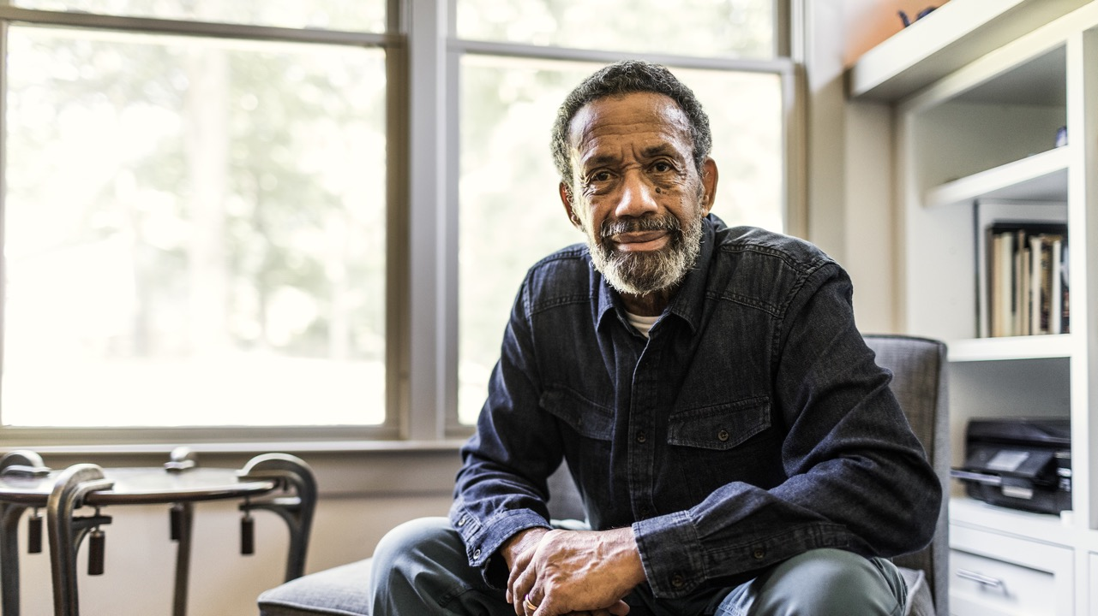
Intersectionality
Intersectionality, through the lens of DEIB, recognizes that individuals may encounter simultaneous forms of discrimination and marginalization.
Emphasizes that these various forms of oppression are intricately connected and cannot be comprehended in isolation.
Notes:
Imperative for understanding and crafting effective strategies within the realm of Health and Wellness Coaching.

Slide 25
1. Race and Ethnicity
Notes:
Race and Ethnicity
Age and Generation Diversity
Gender
Sexual Orientation
Religious and Spiritual Diversity
Physical Disability
Socio-economic Status and Social Determinants of Health
Health Status
Neurodiversity and ADHD
Weight Bias and Stigma

Slide 26
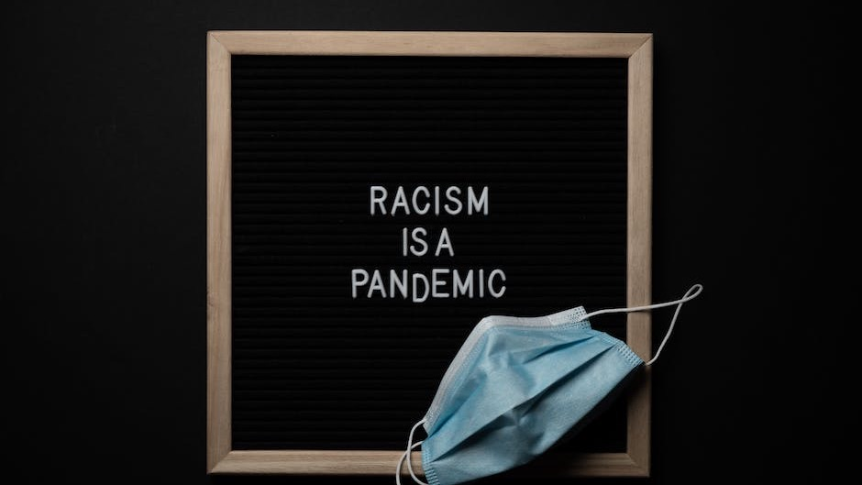
1. Race & Ethnicity: HWC support
Adopt inclusive practice that promote equity and empower individuals from diverse backgrounds
Actively cultivate cultural competence through education: cultural norms, beliefs, etc.
Engage non-judgmentally, fostering a sense of inclusivity and trust
Advocate for elimination of systemic barriers contributing to health disparities
Tailor plans to consider the specific factors impacting clients from different racial and ethnic backgrounds.
Adopt culturally sensitive communication strategies, mindful of language
Serve as advocates for diversity within the HWC profession helping clients feel seen, understood, and supported, ultimately breaking down biases and fostering a more equitable approach

Slide 27
2. Age & Generation Diversity
Notes:
Types of Diversity:
What it is
Why it matters
How HWC can support this type of diversity?
Voices from the Field

Slide 28
2. Age & Generations
Align distinct values for every generation
Focus on age-appropriate health and well-being
Support preventative health: key to longevity
Encourage Health behaviors supporting 70% of aging
Create supportive environment, adding years to life
Help recognize ageism and age-related bias in healthcare and in general
Foster inclusivity by creating a safe and judgment-free space
Notes:
Types of Diversity:
What it is
Why it matters
How HWC can support this type of diversity?
Voices from the Field

Slide 29
3. Gender
Notes:
Race and Ethnicity
Age and Generation Diversity
Gender
Sexual Orientation
Religious and Spiritual Diversity
Physical Disability
Socio-economic Status and Social Determinants of Health
Health Status
Neurodiversity and ADHD
Weight Bias and Stigma

Slide 30
2. Gender
Educate on the latest research and best practices in addressing gender and gender identity health disparities
Raise Awareness to help clients recognize when they are facing gender and gender-related health disparities
Help clients increase emotional agility and develop behavioral strategies to cope with events of gender and gender-related health disparities and discrimination
Help clients create tailored responses and interventions to address specific reoccurring gender and gender-related health disparities and discrimination
Empower clients by addressing the mental effects of gender-related discrimination, such as stress, anxiety, depressive states, low self-esteem, and lack of confidence
Promote health literacy and data collection to help clients educate themselves about their health and social rights
Notes:
Race and Ethnicity
Age and Generation Diversity
Gender
Sexual Orientation
Religious and Spiritual Diversity
Physical Disability
Socio-economic Status and Social Determinants of Health
Health Status
Neurodiversity and ADHD
Weight Bias and Stigma

Slide 31
4. Sexual Orientation
Notes:
Race and Ethnicity
Age and Generation Diversity
Gender
Sexual Orientation
Religious and Spiritual Diversity
Physical Disability
Socio-economic Status and Social Determinants of Health
Health Status
Neurodiversity and ADHD
Weight Bias and Stigma

Slide 32
4. Sexual Orientation
Foster equality, and inclusivity by recognizing and respecting different sexual orientations
Keep abreast of current research, trends, and best practices in LGBTQ+ healthcare
Cultivate an inclusive and welcoming space supporting all sexual orientations
Employ an open, humble, and curious line of questioning
Notes:
Race and Ethnicity
Age and Generation Diversity
Gender
Sexual Orientation
Religious and Spiritual Diversity
Physical Disability
Socio-economic Status and Social Determinants of Health
Health Status
Neurodiversity and ADHD
Weight Bias and Stigma

Slide 33
5. Religion & Spirituality
Notes:
Race and Ethnicity
Age and Generation Diversity
Gender
Sexual Orientation
Religious and Spiritual Diversity
Physical Disability
Socio-economic Status and Social Determinants of Health
Health Status
Neurodiversity and ADHD
Weight Bias and Stigma

Slide 34
5. Religion & Spirituality
Explore with curiosity and compassion the deep beliefs of individuals focusing on the individual nature of people
Take a holistic approach beyond physical body to encompass mental, emotional, social, and spiritual
Engage in active listening to hear the heart and soul of individual
Seek to understand what connects individuals to the world and gives their life meaning
Support individuals to cultivate a deeper relationship with self, others, and the greater universe or God
Provide a level of trust and compassion to create space for processing health status and behavioral change that connect to an optimistic perspective on life
Notes:
Race and Ethnicity
Age and Generation Diversity
Gender
Sexual Orientation
Religious and Spiritual Diversity
Physical Disability
Socio-economic Status and Social Determinants of Health
Health Status
Neurodiversity and ADHD
Weight Bias and Stigma

Slide 35
6. Disability
Notes:
Race and Ethnicity
Age and Generation Diversity
Gender
Sexual Orientation
Religious and Spiritual Diversity
Physical Disability
Socio-economic Status and Social Determinants of Health
Health Status
Neurodiversity and ADHD
Weight Bias and Stigma

Slide 36
6. Disability
Communicate at eye level to build a relationship with a person with a physical disability
Foster inclusivity by creating a safe and judgment-free space
Be sensitive in approaching and interacting without judgement
Address the presence of disability and its effect on daily living
Communicate strengths, values and goals, positive psychology, previous successes, recognize and address emotional barriers, build resilience
Notes:
Sensitivity in approaching and interacting with people with disabilities is essential to be able to communicate effectively…. [and] also address the presence of a disability and its effect on the patient’s ability to perform activities of daily living, participate in health promotion activities, and obtain health care.” (Assessing a Patient With a Disability, 2022).
Race and Ethnicity
Age and Generation Diversity
Gender
Sexual Orientation
Religious and Spiritual Diversity
Physical Disability
Socio-economic Status and Social Determinants of Health
Health Status
Neurodiversity and ADHD
Weight Bias and Stigma

Slide 37
7. Socio-economic Status & Social Determinants of Health
Notes:
Race and Ethnicity
Age and Generation Diversity
Gender
Sexual Orientation
Religious and Spiritual Diversity
Physical Disability
Socio-economic Status and Social Determinants of Health
Health Status
Neurodiversity and ADHD
Weight Bias and Stigma

Slide 38
7. Socio-economic Status & Social Determinants of Health
Embrace population approach that situates individuals in context
Recognize and address the impact of socioeconomic status and social determinants of health
Foster inclusivity by creating a safe and judgment-free space
Learn more about social determinants of health to tailor guidance to each client's unique circumstances
Empower clients by providing education and resources that enhance their understanding of how social determinants impact health outcomes
Advocate for social justice and address systemic barriers
Notes:
Race and Ethnicity
Age and Generation Diversity
Gender
Sexual Orientation
Religious and Spiritual Diversity
Physical Disability
Socio-economic Status and Social Determinants of Health
Health Status
Neurodiversity and ADHD
Weight Bias and Stigma

Slide 39
8. Health Status
Notes:
Race and Ethnicity
Age and Generation Diversity
Gender
Sexual Orientation
Religious and Spiritual Diversity
Physical Disability
Socio-economic Status and Social Determinants of Health
Health Status
Neurodiversity and ADHD
Weight Bias and Stigma

Slide 40
8. Health Status
Recognize unique health needs to tailor support to specific circumstances
Collaborate with healthcare professionals to ensure clients receive coordinated care
Help reduce stigma related to mental health and certain conditions, facilitating help-seeking behaviors
Promote health literacy, empowering clients to make informed decisions
Notes:
Race and Ethnicity
Age and Generation Diversity
Gender
Sexual Orientation
Religious and Spiritual Diversity
Physical Disability
Socio-economic Status and Social Determinants of Health
Health Status
Neurodiversity and ADHD
Weight Bias and Stigma

Slide 41
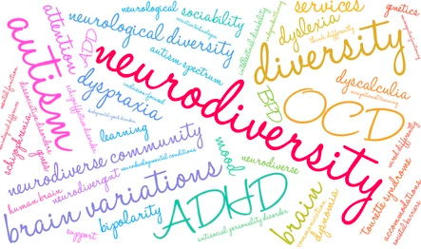
9. Neuro-diversity & ADHD
Notes:
Race and Ethnicity
Age and Generation Diversity
Gender
Sexual Orientation
Religious and Spiritual Diversity
Physical Disability
Socio-economic Status and Social Determinants of Health
Health Status
Neurodiversity and ADHD
Weight Bias and Stigma

Slide 42
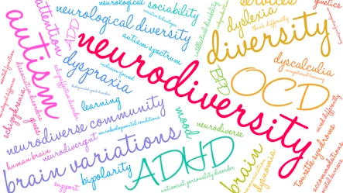
9. Neuro-diversity & ADHD
Address specific health-related challenges: adherence to medication, exercise, nutrition, stress management, and substance abuse (primarily caffeine and nicotine)
Tailor strategies: supporting clients in organizing tasks, managing distractions, regulating sleep patterns, supporting emotional regulation, techniques for memory enhancement
Guide individuals to establish effective communication with their healthcare team
Undergo specialized training to effectively work with Neurodiverse populations
Facilitate group discussions on mental well-being and neurodiversity, actively breaking down barriers and stigmas to promote inclusivity and open dialogues
Notes:
Race and Ethnicity
Age and Generation Diversity
Gender
Sexual Orientation
Religious and Spiritual Diversity
Physical Disability
Socio-economic Status and Social Determinants of Health
Health Status
Neurodiversity and ADHD
Weight Bias and Stigma

Slide 43
10. Weight Bias & Stigma
Notes:
Race and Ethnicity
Age and Generation Diversity
Gender
Sexual Orientation
Religious and Spiritual Diversity
Physical Disability
Socio-economic Status and Social Determinants of Health
Health Status
Neurodiversity and ADHD
Weight Bias and Stigma

Slide 44
9. Weight Bias & Stigma
Challenge weight bias and promote body acceptance
Recognize that health is multifaceted and influenced by various factors beyond weight
Support clients in setting realistic and sustainable health goals that align with their values and preferences
Are mindful of the impact words can have on an individual's mental and emotional well-being
Empower clients to become advocates for their own health and well-being by supporting them in developing self-compassion, body acceptance, and resilience to combat weight stigma
Recognize scope of practice, and refer clients to appropriate professionals
Foster inclusivity by creating a safe and judgment-free space
Notes:
Race and Ethnicity
Age and Generation Diversity
Gender
Sexual Orientation
Religious and Spiritual Diversity
Physical Disability
Socio-economic Status and Social Determinants of Health
Health Status
Neurodiversity and ADHD
Weight Bias and Stigma

Slide 45
VIV. What’s being done

Slide 46
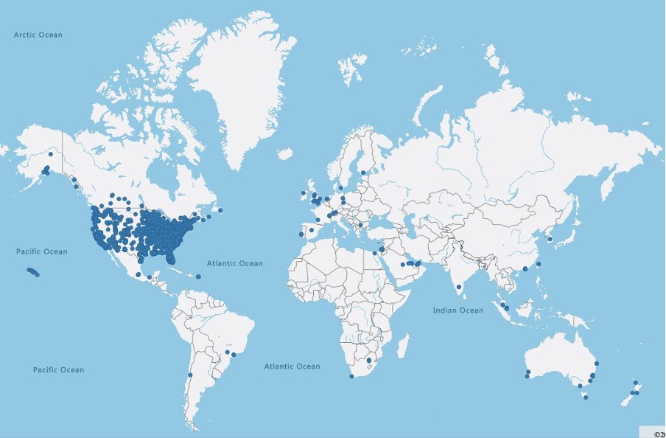
National Board of Health and Wellness Coaching (NBHWC)
Statement on social justice
Integration into ethics
Notes:
As of March 2022, ICF was comprised of 54,177 members in over 140 nations and territories. ICF includes among its members young professionals of the Millennial and Centennial generations as well as members from the Greatest Generation (ICF, 2022).
diversity statement in the 2022 “ICF State of Diversity White Paper”

Slide 47
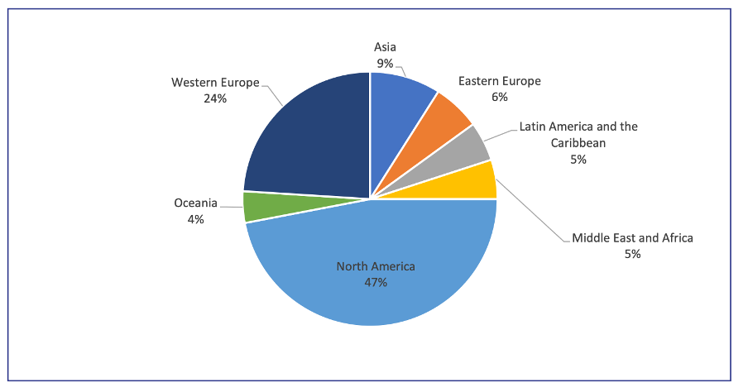
International Coaching Federation (ICF)
54,177 members
Over 140 nations
All generations
Diversity statement in the 2022 “ICF State of Diversity White Paper”
Notes:
As of March 2022, ICF was comprised of 54,177 members in over 140 nations and territories. ICF includes among its members young professionals of the Millennial and Centennial generations as well as members from the Greatest Generation (ICF, 2022).
diversity statement in the 2022 “ICF State of Diversity White Paper”

Slide 48
UK International Health Coach Association
900 members.
20 countries and nationalities.
Equality, Diversity, and Inclusion Policy Statement.
Participating in the NBHWC’s Diversity, Equity & Inclusion Committee
Notes:
The UK & International Health Coaching Association (UKIHCA) is a non-profit professional body for Health Coaching for the UK and Internationally.
As a non-profit established by pro-bono efforts in 2018 and as a small, committed team standing on these shoulders, we are proud of what we have been able to achieve since our inception and in particular, the wins and successes we have achieved so far:

Slide 49
Health & Wellness Coach Specialties
Medical Coaches
Nutrition Coaches
Fitness Coaches
Stress Management Coaches
Mental Health and Well-Being Coaches
Smoking Cessation Coaches
Chronic Disease Management Coaches
Weight Loss Coaches
Holistic Health Coaches
Lifestyle Coaches
Senior Health Coaches
Youth and Teen Health Coaches
Corporate Wellness Coaches
Cancer Wellness Coaches
Gut Health Coaches
Pregnancy and Postpartum Coaches
Wellness Coaches for Specific Populations
Wellness Coaches for Aging in Place
Addiction Recovery Coaches
Holistic Nutrition Coaches
Wellness Coaches for Specific Conditions
End of Life Coaches
Family Caregiver

Slide 50
Calls to Action!
Champion
Health and Wellness Coaching
Embrace
Multicultural Competency
Build
Inclusive Spaces
Implement
DEIB Initiatives
Support
Mental Health and Neurodiversity
Advocate
for Policy Changes
Engage in
in Continuous Learning
Encourage
“Calling In-Out” Culture
Notes:
As authors of the paper and representatives of the Global Wellness Institute Wellness Coaching Initiative, we call upon all readers, including Individuals, Leaders, Service Providers, and Advocates of Diversity, Equity, Inclusion, and Belonging (DEIB), to actively engage in the following Calls to Action:
Champion Health and Wellness Coaching: Recognize the value of Health and Wellness Coaches in promoting DEIB principles in the context of personal well-being. Advocate for the integration of wellness coaching in healthcare settings, workplaces, and communities to provide inclusive, effective, and culturally sensitive support.
Embrace Multicultural Competency: Individuals, leaders, and service providers are encouraged to embrace multicultural competency actively. This involves fostering an understanding and appreciation of diverse cultural backgrounds, experiences, and needs. Seek opportunities for education, training, and mentorship to enhance cultural competence in personal and professional settings.
Promote Inclusive Spaces: Leaders and advocates of DEIB should actively work to create and promote inclusive spaces within their organizations and communities. This includes recognizing and addressing instances of bias, discrimination, and microaggressions. Foster an environment where individuals from all backgrounds feel valued, heard, and respected.
Implement DEIB Initiatives: Leaders and service providers should champion and implement DEIB initiatives within their organizations. This involves developing and enforcing policies that promote equity, fostering diversity in leadership roles, and ensuring that all individuals have equal opportunities for growth and advancement.
Support Mental Health and Neurodiversity: Individuals and advocates of DEIB should actively support mental health awareness and neurodiversity. Destigmatize conversations around mental health, promote understanding of neurodivergent conditions, and encourage open discussions to break down barriers to mental health support and inclusion.
Advocate for Policy Changes: Advocates and leaders can contribute to larger systemic change by advocating for policies that address health disparities, promote inclusivity, and reduce barriers to equitable healthcare. Engage in conversations with policymakers, join advocacy groups, and use collective voices to drive positive policy changes.
Engage in Continuous Learning: Individuals and leaders alike should commit to continuous learning about DEIB topics. Stay informed about current research, best practices, and evolving perspectives on diversity, equity, inclusion, and belonging. Encourage a culture of learning within organizations to foster ongoing growth and understanding.
Promote “Calling In-Out” Culture: Encourage a culture of "calling in" within organizations and communities. Recognize that individuals may unintentionally cause harm and create opportunities for constructive dialogue to address issues of bias or discrimination. Support each other in the journey toward understanding and growth.
By actively engaging in these Calls to Action, each reader can contribute to a more inclusive, equitable, and thriving world. The collective efforts of Individuals, Leaders, Service Providers, and Advocates of DEIB can bring about positive change, fostering a global environment where everyone can thrive and enjoy optimal well-being.
Conclusion
This paper shows that the DEIB conversation is paramount in 2023 and that accredited, well-trained Health and Wellness Coaches stand at the forefront, playing a pivotal role in supporting DEIB initiatives. Their skills and knowledge enable them to navigate the complex landscape of human health and well-being, fostering inclusivity and equity in their practice. By prioritizing DEIB principles, these coaches contribute to the holistic betterment of their clients and society, embodying agents of positive change in the realm of wellness.

Slide 51
Conclusions
DEIB conversation paramount
Accredited, well-trained Health and Wellness Coaches stand at forefront, playing a pivotal role in supporting DEIB initiatives
Skills and knowledge enable coaches to:
Navigate complex landscape of health and well-being
Foster inclusivity and equity
Contribute to holistic betterment of clients and society
Embody agents of positive change

Slide 52
Thank You
All pictures free-sourced through Microsoft or Unsplashed.

Slide 53
Disclaimers
These presentation slides have been produced as part of the Global Wellness Institute Wellness Coaching Initiative (GWI WCI).
They are designed to support Credentialed/Certified Health and Wellness Coaches (HWC) to create the ripple effect through events and marketing. The presentation is provided for educational use only.
These presentation slides present the key findings from the “GWI WCI White Paper: Towards Advancing Health and Wellness Coaching: Where We Are and What Needs to Happen”, published in February 2022. They are designed to raise awareness about HWC through an understanding of the state of the Credentialed Health and Wellness Coaching profession globally, the increasing variety of delivery settings, as well as global trends and recommendations for the future.
Do
Add a Fair-Use Disclaimer such as “I do not own this content. All credits go to its rightful owner”
Use to raise awareness with your clients, corporations, organizations, communities
Share with other Credentialed/Certified HWC, on social media or your website
Add your own flavor (logo) or other information to adapt to your needs
Refer to the White Paper or its authors if anything is unclear or for further information
Note that this presentation may not include all relevant facts or the most up-to-date research at the time of presentation. GWI WCI is not liable if omissions or errors occur after publication.
Don’t
Remove GWI logo, references, or authors
Change any of the data provided
Reproduce any part of this presentation for your own use unless with written permission of the owner (GWI WCI)

Slide 54
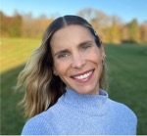
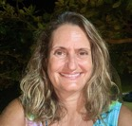
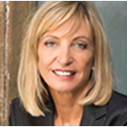
Authors
Izabella Natrins
CEO UK & International Health Coaching Association
izabella@ukihca.com
Beth Romanski
Integrative Health and Wellness Coach
beth@myhealthytransitions.com
Ellen Kocher
Master HWC, ICF PCC, NBC-HWC
ekocher@whealthness.ch
Darrell Rogers
Director of Advocacy | Government & Business Relations | Health and Wellness Policy Expert
darrell@binwellgroup.com
Dr. Kat Gisbert-Tay
Medical Doctor
BSc PSYCH
Duke Integrative HC
ICF PCC, NBC-HWC
drkat@thecoachpartnership.com
Jocelyn Pepe
MSc., PCC, RHCTM
jocelyn@truliving.ca
Shiri Ben-Arzi
PMC, MCC
Founder, Director and Master Trainer at MCI Medical Coaching Institute
shiri@mci-il.com
Fiona Cosgrove
Mast Ex Sci, Mast Counselling, NBC-HWC, ICFPCC
fiona@wellnesscoachingaustralia.com.au
M.Carolina Tuma
PhD, NBHWC
carolina@carolinatuma.com
Notes:
Shiri Ben-Arzi - PMC, MCC
Founder, Director and Master Trainer at MCI Medical Coaching Institute
shiri@mci-il.com

Slide 55
Special thanks to our Guest Contributors
Dr. Michelle May mmay@amihungry.com
Nina Raffaele Aponte nina@bienstar.coach
Hélène Thériault Helene@functionfirstcoaching.com
Andrew Parsons andrewaparsons@gmail.com
Lauren Dixon ldixon@muih.edu
Sarah Doll-Steinberg sarah@themindpractice.com
Notes:
Shiri Ben-Arzi - PMC, MCC
Founder, Director and Master Trainer at MCI Medical Coaching Institute
shiri@mci-il.com

Slide 56
Inclusive Language Glossary Links
General Inclusive Language Guide
Specific Inclusive Language Guide: Race & Ethnicity
Specific Inclusive Language Guidelines: Disability
Specific Glossary of Gender & Sexual Identity Terminology for professionals
Specific Inclusive Language Guide for Weight Stigma and Bias Terminology
Notes:
General Inclusive Language Guide: https://us.sagepub.com/en-us/nam/inclusive-language-guide.
Specific Inclusive Language Guide: Race & Ethnicity
https://www.apa.org/about/apa/equity-diversity-inclusion/language-guidelines
Specific Inclusive Language Guidelines: Disability
https://www.ungeneva.org/en/about/accessibility/disability-inclusive-language
Specific Glossary of Gender & Sexual Identity Terminology for professionals: https://www.genderhealthtraining.com/wp-content/uploads/2023/12/GHTI-Glossary-v122023.pdf
Specific Inclusive Language Guide for Weight Stigma and Bias Terminology: https://pubmed.ncbi.nlm.nih.gov/35819360/

Slide 57
Join the movement!
Follow Us on LinkedIn: Wellness Coaching Initiative (Part of the Global Wellness Institute)
Want to contribute?
Health and Wellness Coaching Connection Blog Space. It is our mission to empower individuals and businesses around the world to confidently partner with wellness coaches, optimizing health and well-being and clarifying wellness coach specialties and global guidelines through education and community resources. The GWI WCI Blog is one of these resources intended to advance the global Health & Wellness Coaching Community by providing accessible, evidence-based articles related to the field of Health & Wellness Coaching. Blogs will be posted on our area of the GWI website and cross-posted on LinkedIn. Learn more here :
Wellness Coaching Connection Contributor Guidelines Blog-Newsletter Submission Form
Please email us (gwiwci2023@gmail.com) if anything is unclear or if you have questions. We look forward to receiving your submissions!

Slide 58
2024

